Slide 1
Microwave and Satellite Communication
CSTE 3203

Slide 2
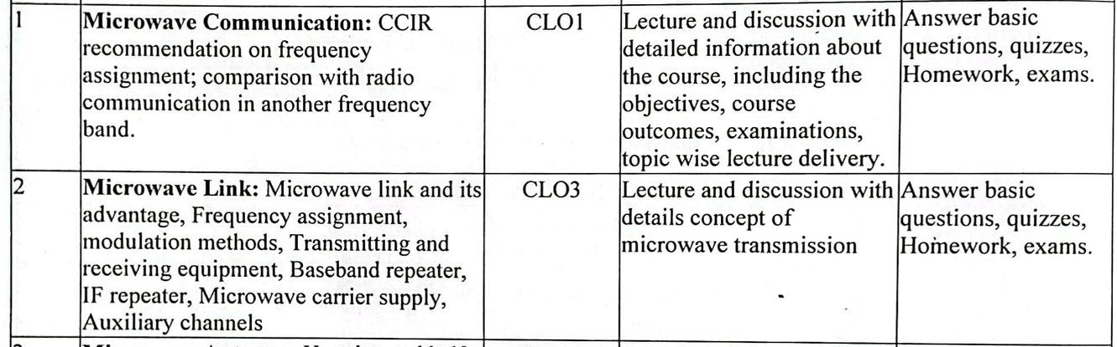

Slide 3
Microwave Communication
Introduction

Slide 4
Microwave
Microwave is a line-of-sight wireless communication technology that uses high frequency beams of radio waves to provide high speed wireless connections that can send and receive voice, video, and data information.
The wavelengths ranging from as long as 1 meter to as short as 1 millimeter or equivalently with frequencies between 300 MHz (0.3 GHz) to 300 GHz.

Slide 5
Background of Millimeter Wave
The frequencies above 30 GHz and below 100 GHz of the radio electromagnetic spectrum, are called “millimeter waves” because their wavelengths are conveniently measured in millimeters, and their wavelengths range from 10 mm down to 3.0 mm.
Radio waves in this band are strongly attenuated by the Earth’s atmosphere and particles contained in it, especially during wet weather. Also in wide band of frequencies around 60 GHz, the radio waves are strongly attenuated by molecular oxygen in the atmosphere.

Slide 6
Microwave Frequency Bands

Slide 7
Microwave Frequency Bands
Radio Waves are defined by Radio Regulations of the International telecommunication Union (ITO). The radio spectrum allocated for Microwave are UHF,SHF and EHF as mentioned below in the table:
Band Number | Symbol | Frequency Range | Corresponding Metric Subdivision
4 | VLF | 3 to 30 kHz | Myriametric waves
5 | LF | 30 to 300 kHz | Kilometric waves
6 | MF | 300 to 3000 kHz | Hectometric waves
7 | HF | 3 to 30 MHz | Decametric waves
8 | VHF | 30 to 300 MHz | Metric waves
9 | UHF | 300 MHz to 3 GHz | Decimetric waves
10 | SHF | 3 to 30 GHz | Centimetric waves
11 | EHF | 30 to 300 GHz | Milimetric waves
12 |  | 300 to 3000 GHz | Decimilimetric waves

Slide 8
Frequency Assignment
Microwave signals are divided into three categories:
Ultra high frequency (UHF) (0.3-3 GHz)
Super high frequency (SHF) (3-30 GHz) and
Extremely high frequency (EHF) (30-300 GHz).
In addition, microwave frequency bands are designated by specific letters.

Slide 9
Microwave Frequency Bands
L band 1 to 2 GHz S band 2 to 4 GHz C band 4 to 8 GHz X band 8 to 12 GHz Ku band 12 to 18 GHz K band 18 to 26.5 GHz Ka band 26.5 to 40 GHz Q band 30 to 50 GHz U band 40 to 60 GHz V band 50 to 75 GHz E band 60 to 90 GHz W band 75 to 110 GHz F band 90 to 140 GHz D band 110 to 170 GHz

Slide 10
Microwave Frequency Bands
Lower Microwave frequencies are used for longer links, and regions with higher rain fade. Conversely, Higher frequencies are used for shorter links and regions with lower rain fade.

Slide 11
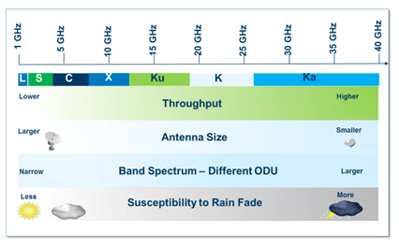
Microwave Frequency Bands

Slide 12
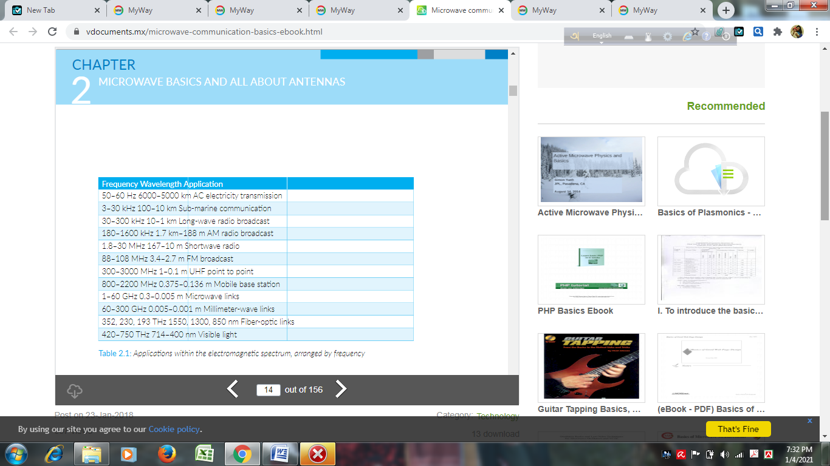
Radio Wave Arranged by Frequency

Slide 13
Modulation Techniques
Binary Phase shift keying (BPSK)
QPSk
8-ary PSK
M-ary PSK
4-QAM
8 –QAM
16-QAM
Having large discrete states, we can transmit more information per state.

Slide 14
Example: Model of a Digital Communication System
Message
e.g. English symbols
Encoder
e.g. English to 0,1 sequence
Information
Source
Coding
Communication
Channel
Destination
Decoding
Can have noise
or distortion
Decoder
e.g. 0,1 sequence to English

Slide 15
Shannon Wants to…
Shannon wants to find a way for “reliably” transmitting data throughout the channel at “maximal” possible rate.
Information
Source
Coding
Communication
Channel
Destination
Decoding

Slide 16
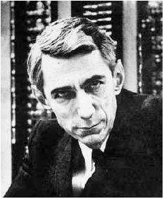
Shannon’s Vision
Data
Source
Encoding
Channel Encoding
Channel
User
Source Decoding
Channel Decoding

Slide 17
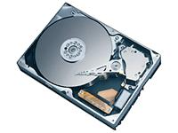
Example: Disk Storage
Data
Zip
Add CRC
Channel
User
Unzip
Verify CRC

Slide 18
In terms of Information Theory Terminology
Zip
Source
Encoding
=
Data Compression
Unzip
Source Decoding
=
Data Decompression
Add CRC
Channel Encoding
=
Error Protection
Verify CRC
Channel Decoding
=
Error Correction
cyclic redundancy check (CRC)

Slide 19
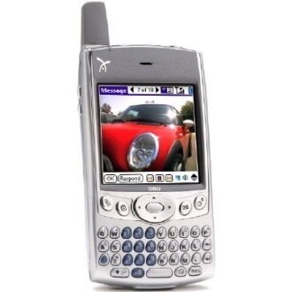
Example: Cellular Phone
Speech Encoding
CC Encoding
Channel
Speech Decoding
CC Decoding
GSM/CDMA
CC stands for Convolutional Code.

Slide 20
For Digital Microwave
PCM techniques used
PCM adopted for digital multiplexing of channels. Number of channel are multiplexed by time division multiplexing to form digital base band signal.
Stages are: filtering, sampling, quantizing, encoding, linecoding
Example:
Filtering:0-4KHz (low pass voice signal filter)
Sampling: Sampling rate or frequency- 8KHz; sampling time period 1/8000s= 125 microsecond;
Quantization & Encoding: 2⁸=256 level (128 for positive swing and 128 for negative swing); produce 8 bit code word(sign, segment, position)
Linecoding: For Ac coupled transmission line HDB3 (high density binary 3 coding) is employed. Bit/sec= bit/frame * frame/sec

Slide 21
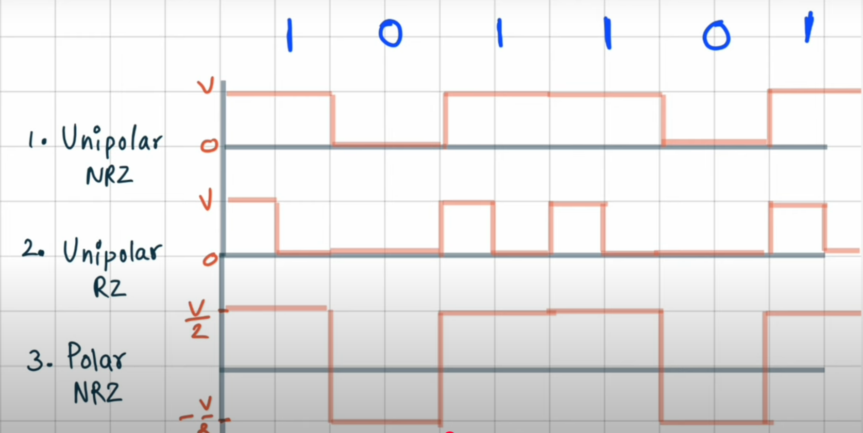

Slide 22
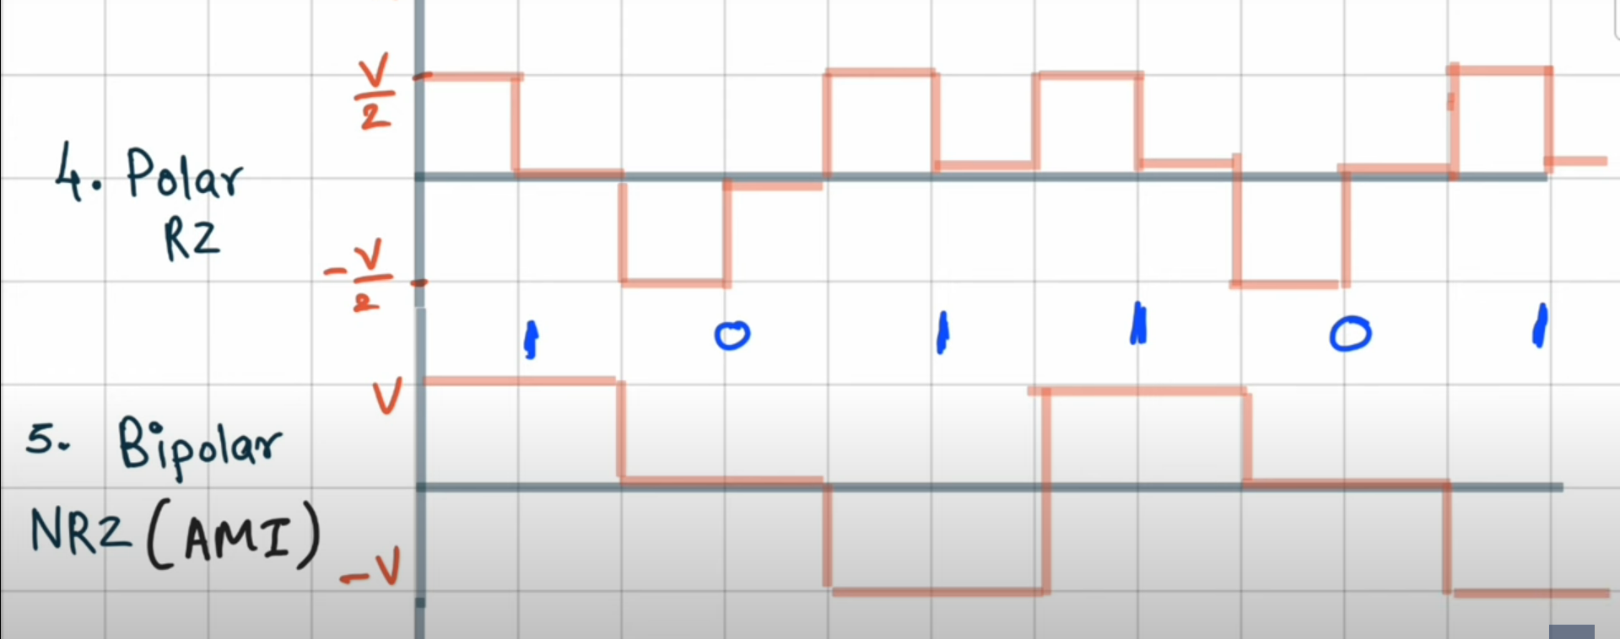

Slide 23
Advantages
Due to their high operating frequencies, microwave systems can carry large quantities of information.
It requires small antennas.
Distances between switching centers are less.
Minimum crosstalk exists between voice channels.
Few repeaters are necessary for amplification.
Increased reliability and less maintenance are important factors.
The microwave band has a bandwidth 30 times that of all the rest of the radio spectrum below it.

Slide 24
Disadvantages
It is more difficult to analyze, circuit design and measuring techniques at microwave frequencies.
Transient time is more critical.
It is necessary to use specialized components.
Microwave frequencies propagate in straight line, which further limits their use to LOS applications.

Slide 25
Application
Microwave links are widely used for point-to-point communications on Earth surface.
Small wavelength allows conveniently-sized antennas to direct them in narrow beams, which can be pointed directly at the receiving antenna. This allows nearby microwave equipment to use the same frequencies without interfering with each other, as lower frequency radio waves do.
Microwave frequency spectrum is used for telephone communications. Many long-distance telephone systems use microwave relay links for carrying telephone calls.
With multiplexing techniques, thousands of two-way communications are modulated on a single carrier and then relayed from one station to another over long distances.

Slide 26
Application
Radar (Radio Detection and Ranging) also operates in the microwave region. It is a method of detecting the presence of a distant object and determining its distance and direction. Radar systems transmit a high-frequency signal which is then reflected from the distant object. The reflected signal is picked up by the radar unit and compared to the transmitted signal. The time difference between the two gives the distance to the object.
Television stations and networks use microwave relay links to transmit TV signals over long distances rather than rely on coaxial cables.
A growing application for microwave communications is space communications. Communications with satellites, deep-space radio communications /probes, and other spacecraft is usually done by microwave transmission. This is due to the reason that microwave signals are not reflected or absorbed by the ionosphere as of many lower-frequency signals.
Radio navigation systems, sensor systems, radio astronomy etc. are other applications.

Slide 27
Application
Backbone links and “Last Mile” Communication for cellular network operators.
Backbone links for Internet Service Providers (ISPs) and Wireless ISPs (WISPs)
Corporate Networks for Building to Building and campus sites.

Slide 28
Planning of microwave links
Microwave links provider (companies) planned for microwave links, considering the following parameters:
Required distance (km/miles) and capacity (Mbps)
Desired Availability target (%) for the link
Availability of Clear Line of Sight (LOS) between end nodes
Towers if required to achieve clear LOS
Allowed frequency bands specific to region/country
Environmental constraints, including rain fade
Cost of licenses for required frequency bands

Slide 29
Types of Microwave System
Feeder service microwave systems: Generally categorized as short haul since they are used to carry information for relatively short distances, such as between cities within the same state.
Long haul microwave systems: Used to carry information for long distances.

Slide 30
Microwave Repeaters
Microwave communications requires the line-of-sight or space wave propagation method. There are some instances where barriers are inevitable which cause obstructions between the transmitter and receiver. This kind of problem is best resolved by repeaters.

Slide 31
Microwave Repeaters
Passive Repeater
It is a device used to re-radiate the intercepted microwave energy without the use of additional electronic power. It also has the ability to redirect intercepted microwave radars to the other direction.

Slide 32
Microwave Repeaters
Active Repeater
It is a receiver and a transmitter placed back to back or in tandem with microwave repeaters. There are two types of active repeater namely: baseband and heterodyne or IF.
In baseband repeaters, the received radio frequency (RF) carrier is down-converted to an intermediate frequency (IF), amplified, filtered, and then demodulated to baseband signal.
In a heterodyne repeater, the received RF carrier is down-converted to an IF, amplified, reshaped, up-converted to RF, and then retransmitted. Note that, the signal is never demodulated below IF.

Slide 33
Automatic Adaptation and Coding
The goal of Adaptive Modulation is to improve the operational efficiency of Microwave links by increasing network capacity over the existing infrastructure . Adaptive Modulation means dynamically varying the modulation in an errorless manner in order to maximize the throughput under momentary propagation conditions. In other words, a system can operate at its maximum throughput under clear sky conditions, and decrease it gradually under rain fade. For example a link can change from 256QAM down to QPSK to keep “link alive” without losing connection.
Prior to the development of Automatic Coding and Modulation, microwave designers had to design for “worst case” conditions to avoid link outage.
The benefits of using ACM include:
Longer link lengths (distance)
Using smaller antennas
Higher Availability (link reliability)

Slide 34
Microwave Tx/Rx for Satellite
Tx
BB signal in
Up
converter
Encoder
Modulator
HPA
BB signal o/p
Down
converter
Low noise Amp
Decoder
Demodulator
Rx

Slide 35
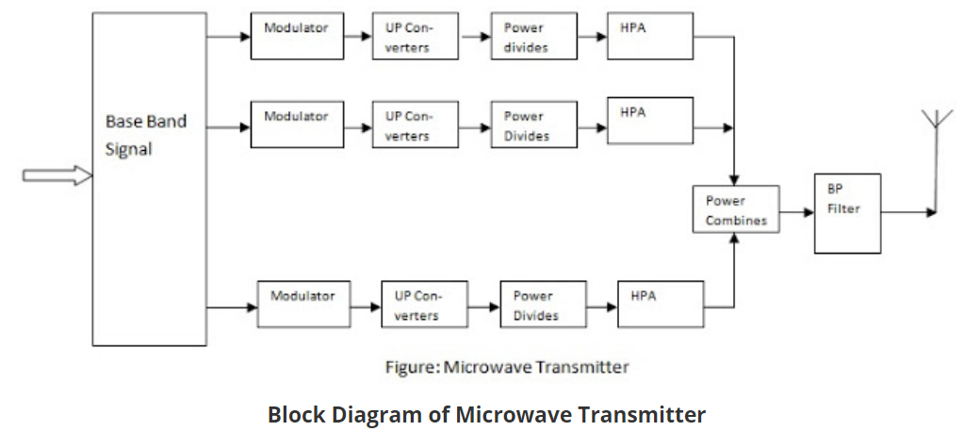

Slide 36
Microwave Transmitter
The signal to be transmit, must be at uplink frequency. The converter multiply the signal frequency to uplink frequency after it is encoded and modulated properly. After up converting the frequency, it is applied to power dividers. The output of power divider goes to high power amplifier. Normally travelling wave tube amplifiers or multi cavity klystron amplifiers are used. These tubes require good amount of cooling.
Here the modulation is performed at 70 MHz intermediate frequency and is then up converted to a uplink frequency of 6 GHz. The output of several high power amplifiers are combined in a power combining amplifier and the output then passes through band pass filter and circulators. Frequency stability and power control are necessary to avoid interferences.

Slide 37
Microwave Receiver
The first stage of the terminal station receiver is the front end converter which is usually a double converter to convert the down link frequency signal of the order of GHz into an intermediate frequency of 70 MHz. Now this intermediate frequency signal is first passed through a chain of bandpass filters and amplifier combinations to improve signal strength. Thus the IF signal is demodulated to get the original baseband signal.

